Slide 1
Hybris Web Services
Module - 20

Slide 2
Contents
Overview

Slide 3
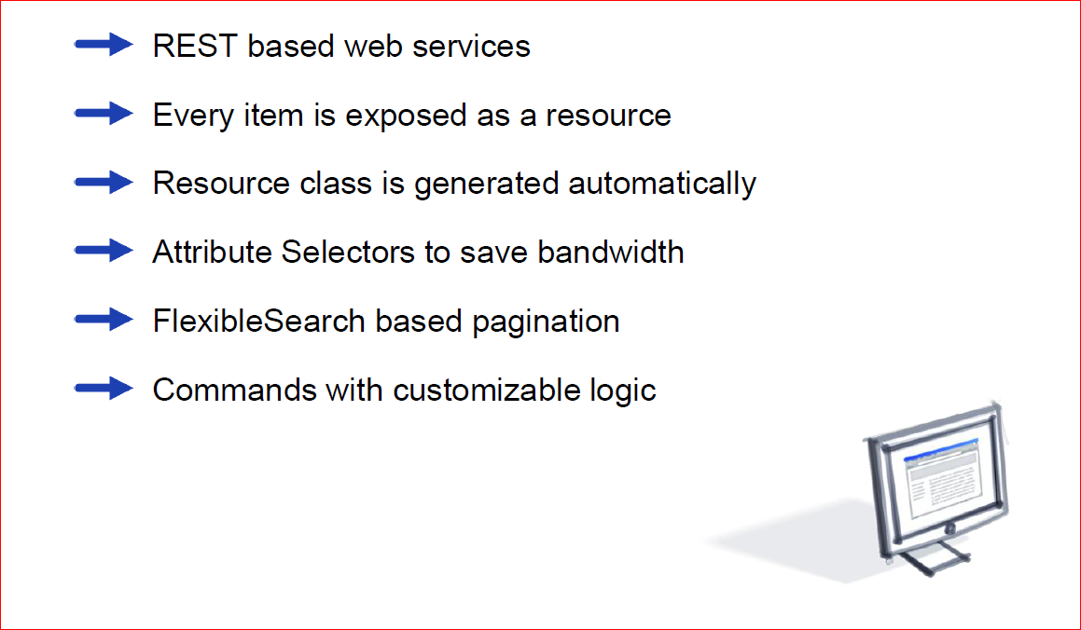
Overview

Slide 4
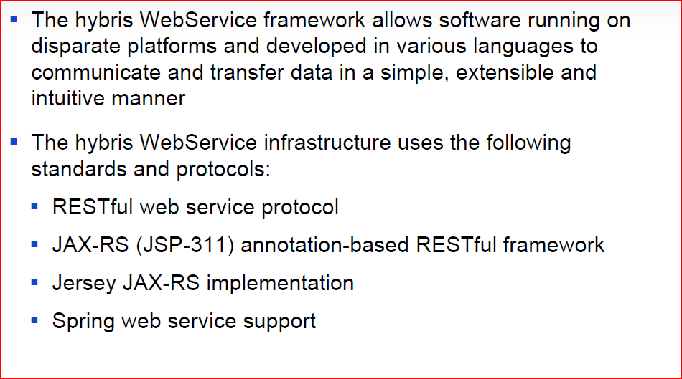
hybris Web Services - Key Features

Slide 5
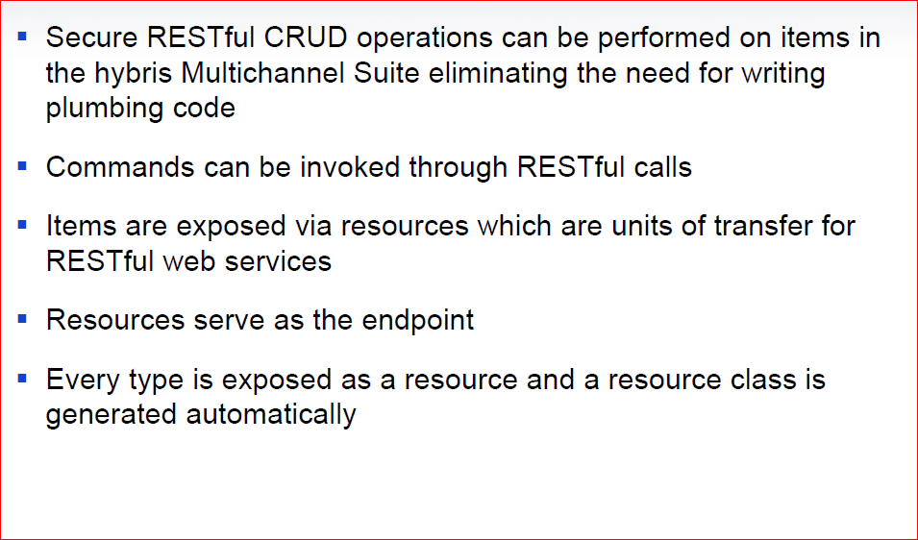
hybris Web Services - Key Features

Slide 6
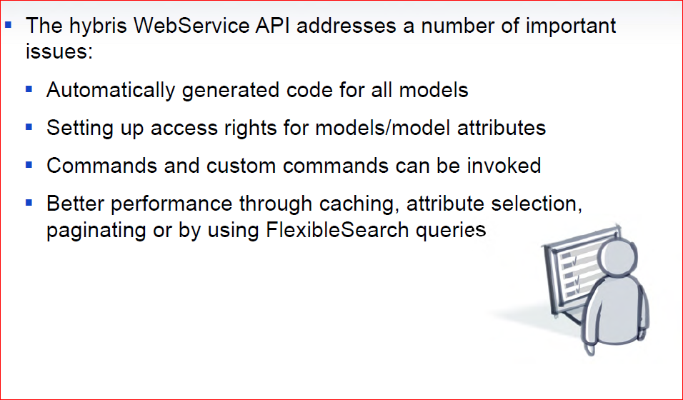
hybris Web Services - Key Features

Slide 7
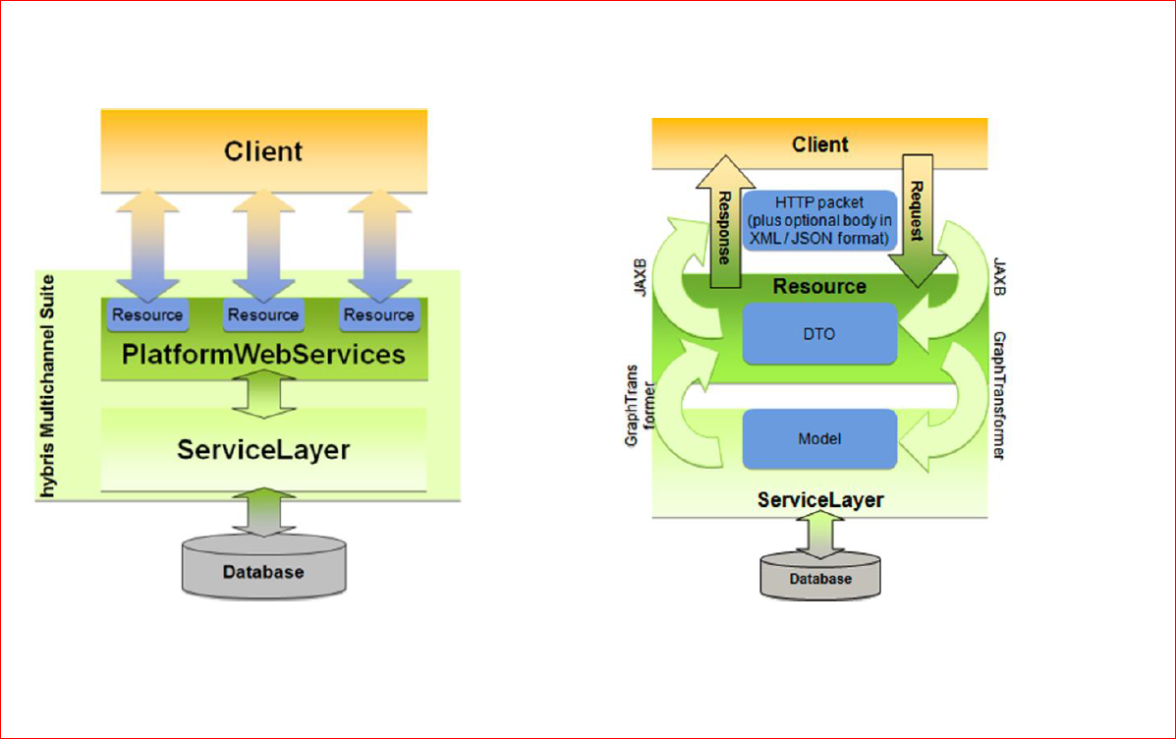
Architecture Overview

